Slide 1
Expression Conversion
Presented By S.R.Zameer

Slide 2
Expression Conversion
Any expression can be represented using three types of expressions (Infix, Postfix and Prefix). We can also convert one type of expression to another type of expression like Infix to Postfix, Infix to Prefix, Postfix to Prefix. To convert any Infix expression into Postfix or Prefix expression we can use the following procedure...
Find all the operators in the given Infix Expression.
Find the order of operators evaluated according to their Operator precedence.
Convert each operator into required type of expression (Postfix or Prefix) in the same order.

Slide 3
Example
Consider the following Infix Expression to be converted into Postfix Expression...
D = A + B * C

Slide 4
Process
Step 1: The Operators in the given Infix Expression : = , + , *
Step 2: The Order of Operators according to their preference : * , + , =
Step 3: Now, convert the first operator * ----- D = A + B C *
Step 4: Convert the next operator + ----- D = A BC* +
Step 5: Convert the next operator = ----- D ABC*+ =

Slide 5
Output
Finally, given Infix Expression is converted into Postfix Expression as follows...
D A B C * + =

Slide 6
Infix to Postfix Conversion using Stack Data Structure
To convert Infix Expression into Postfix Expression using a stack data structure, We can use the following steps...
Read all the symbols one by one from left to right in the given Infix Expression.
If the reading symbol is operand, then directly print it to the result (Output).

Slide 7
Contd…
If the reading symbol is left parenthesis '(', then Push it on to the Stack.
If the reading symbol is right parenthesis ')', then Pop all the contents of stack until respective left parenthesis is poped and print each poped symbol to the result.
If the reading symbol is operator (+ , - , * , / etc.,), then Push it on to the Stack. However, first pop the operators which are already on the stack that have higher or equal precedence than current operator and print them to the result.

Slide 8
Example
Consider the following Infix Expression...
( A + B ) * ( C - D )

Slide 9
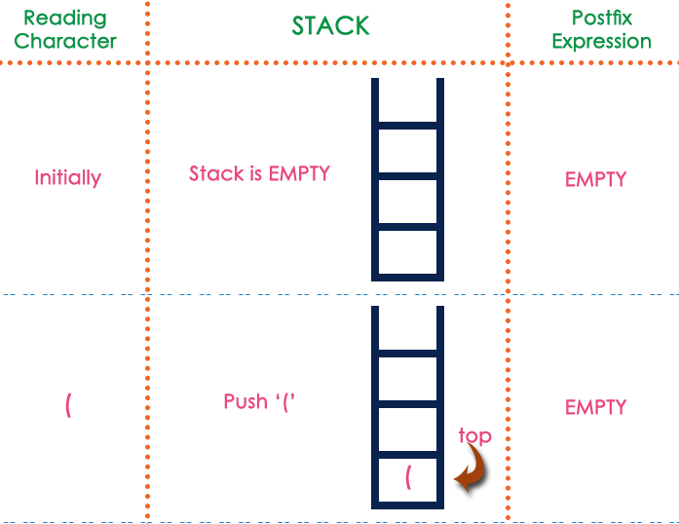
Process

Slide 10
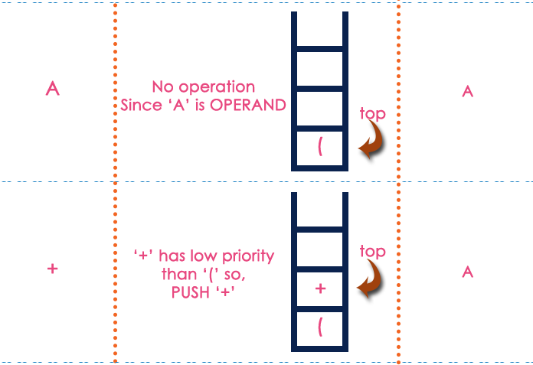

Slide 11
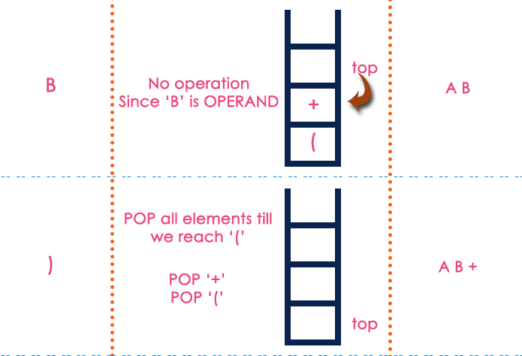

Slide 12
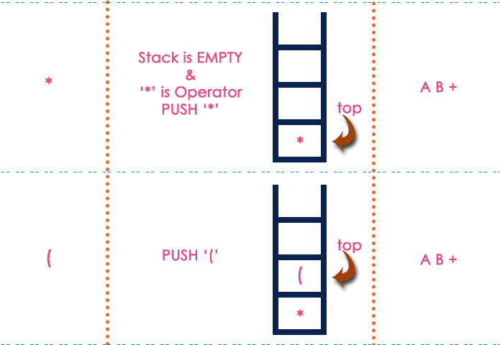

Slide 13
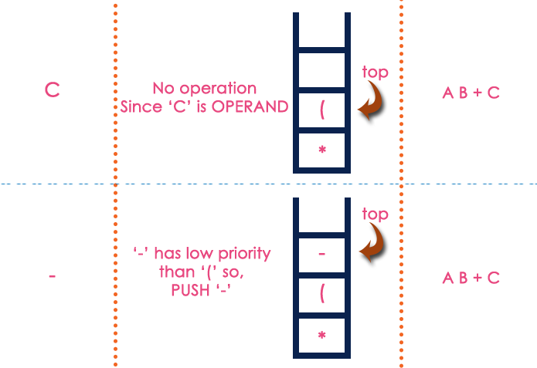

Slide 14
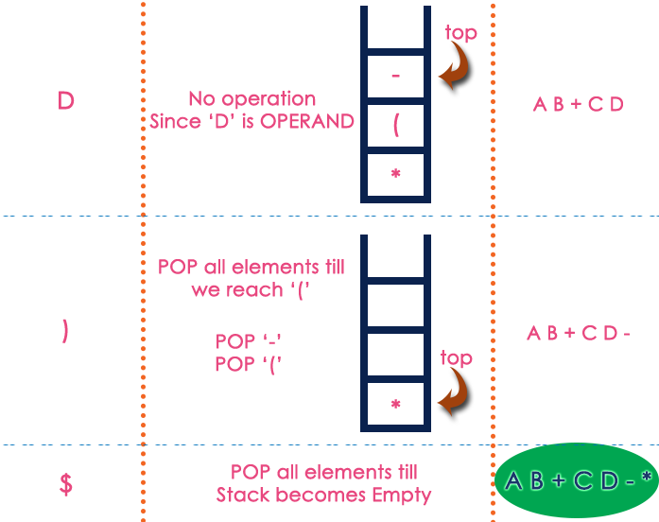

Slide 15
Output
The final Postfix Expression is as follows...
A B + C D - *

Slide 16
Postfix Expression Evaluation
A postfix expression is a collection of operators and operands in which the operator is placed after the operands. That means, in a postfix expression the operator follows the operands. Postfix Expression has following general structure...
Operand1 Operand2 Operator

Slide 17
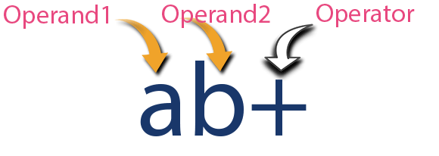
Example

Slide 18
Postfix Expression Evaluation using Stack Data Structure
A postfix expression can be evaluated using the Stack data structure. To evaluate a postfix expression using Stack data structure we can use the following steps...
Read all the symbols one by one from left to right in the given Postfix Expression
If the reading symbol is operand, then push it on to the Stack.

Slide 19
Contd…
If the reading symbol is operator (+ , - , * , / etc.,), then perform TWO pop operations and store the two popped oparands in two different variables (operand1 and operand2). Then perform reading symbol operation using operand1 and operand2 and push result back on to the Stack.
Finally! perform a pop operation and display the popped value as final result.

Slide 20
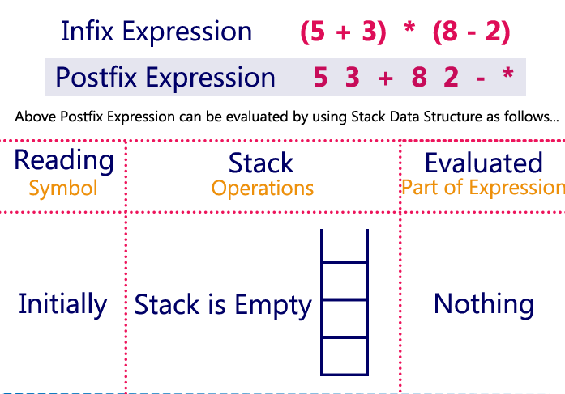
Example

Slide 21
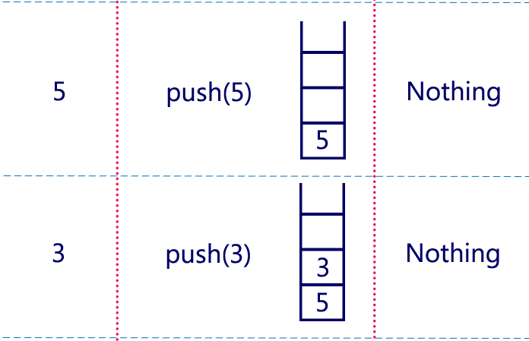

Slide 22
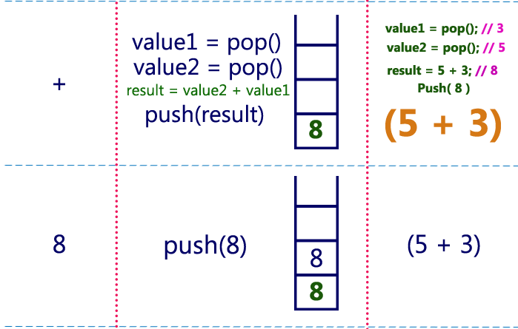

Slide 23
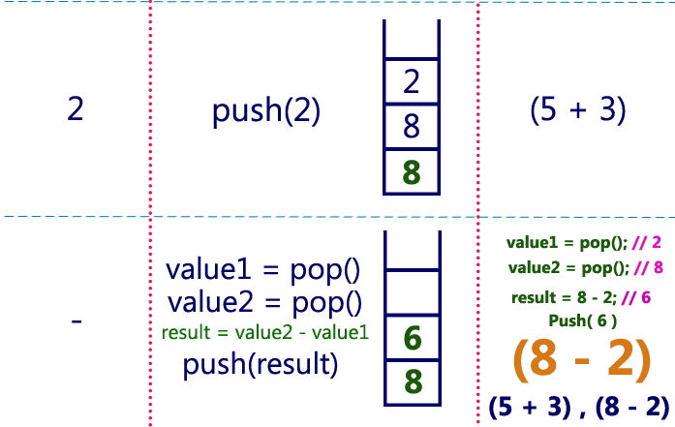

Slide 24
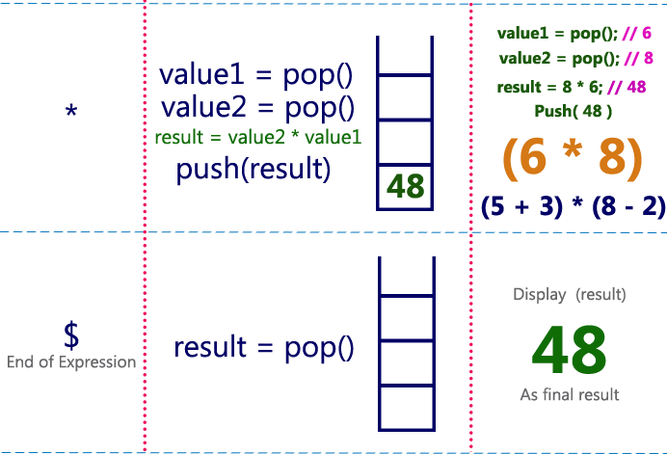

Slide 25
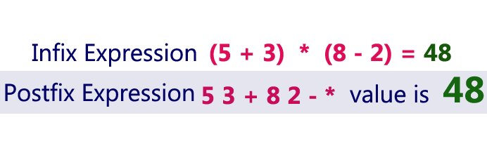
Output

